Slide 1

T.J.S. ENGINEERING COLLEGE DEPARTMENT OF COMPUTER SCIENCE AND ENGINEERING
DISEASE PREDICTION USING MACHINE LEARNING
TEAM MEMBERS:
USHA G B
MANUGUNTA DEVI PRASANTHI
VUNNAM SANTHOSH
PROJECT SUPERVISED BY:
Ms. PAVITRA. V

Slide 2
PROBLEM STATEMENT:
The rise of chronic diseases coupled with the increasing availability of healthcare data has prompted the exploration of machine learning approaches for disease prediction. The objective of this project is to develop robust predictive models that can accurately forecast the occurrence or progression of various diseases based on patient data . This project focuses on predicting the risk of specific diseases, including but not limited to cardiovascular diseases, diabetes, cancer, and neurological disorders. The scope encompasses the development of predictive models using supervised learning techniques and does not include treatment recommendations or clinical decision-making.

Slide 3
ABSTRACT:
Disease Prediction using Machine Learning:
System used to predict diseases from given symptoms
Provided symptoms as input
Outputs probability of disease
Naïve Bayes Classifier:
Utilized for disease prediction
Supervised machine learning algorithm
Medical Data Analysis:
Accurate analysis benefits early disease detection and patient care
Linear regression and decision tree used for predicting diseases like Diabetes, Malaria, Jaundice, Dengue, and Tuberculosis
Changing Health Information Needs:
Information seeking behavior observed globally
Challenges in seeking online health information regarding diseases, diagnoses, and treatments
Recommendation System for Healthcare:
Potential to save time for doctors and patients
Utilizes review mining

Slide 4
EXISTING SYSTEM:
The existing system predicts the chronic diseases which are for a particular region and for the particular community. Only particular diseases are predicted by this system. In this System, CNN Algorithm is used for Disease risk prediction. The system is using Machine Learning algorithm i.e. K-nearest Neighbors, Decision Tree, Naïve Bayesian. The accuracy of the existing System is up to 94.8%. In the existing paper, they streamline machine learning algorithms for the effective prediction of chronic disease outbreak in disease-frequent communities. They experiment with the modified prediction models over real life hospital data collected from central China. They propose a convolutional neural network-based multimodal disease risk prediction(CNN-MDRP) algorithm using structured and unstructured data from the hospital. This experimental study is focused on developing a highly accurate disease prediction model using a dataset containing multiple records of documented diseases and symptoms for each disease, in combination with three machine learning classification algorithms. In order to achieve as high a level of accuracy as possible, the model that achieves the best results will be tuned further. During times when doctors are overburdened, this could be an effective method of assisting them with diagnosing diseases.

Slide 5
PROPOSED SYSTEM:
Most of the chronic diseases are predicted by our system. It accepts the structured type of data as input to the machine learning model. This system is used by end-users i.e. patients/any user. In this system, the user will enter all the symptoms from which he or she is suffering. These symptoms then will be given to the machine learning model to predict the disease. Algorithms are then applied to which gives the best accuracy. Then System will predict disease on the basis of symptoms. This system uses Machine Learning Technology. Random Forest is used to the algorithm generates decision trees based on different data samples, and in cases of classification and regression, Random Forest Algorithm has the advantage of being able to handle both continuous and categorical variables, continuous as a part of regression problems and categorical variables as a part of classification. Naïve Bayes algorithm is used for predicting the disease by using symptoms, logistic regression is used for extracting features which are having most impact value, the Decision tree is used to divide the big dataset into smaller parts. The final output of this system will be the disease predicted by the model.

Slide 6
LITERATURE SURVEY:
M. Chen proposed a new CNN based multimodal disease risk prediction algorithm by using structured and unstructured data of hospital. M. Chen ,Y. Hao, K. Hwang, L. Wang, and L. Wang invented disease prediction system for the numerous regions. They performed disease prediction on three diseases like diabetics, cerebral infraction and heart disease. The disease prediction is carried out on structured data. Prediction of heart disease, diabetes and cerebral infraction is carried out by using different machine learning algorithm like naïve bayes, Decision tree and KNN algorithm. The result of Decision tree algorithm is better than Naïve bayes and KNN algorithm. Also, they predict that whether a patient experiences from the high risk of cerebral infarction or low risk of cerebral infarction. For the risk prediction of cerebral infraction, they utilized CNN based multimodal disease risk prediction on text data. The accuracy comparison takes place between CNN based unimodal disease risk predictions against CNN based multimodel disease risk prediction algorithm. The accuracy of disease prediction reaches up to the 94.8% with faster speed than CNN based unimodal disease risk prediction algorithm. The CNN based multimodel disease risk prediction algorithm steps is similar as that of the CNN-UDRP algorithm only the testing steps consist of two additional steps. This paper work on both the type of dataset like structured and unstructured data. Author worked on unstructured data. While previous work only based on structured data, none of the author worked on unstructured and semi- structured data. But this paper depends on structured as well as unstructured data.
B. Qian, X. Wang, N. Cao, H. Li, and Y.-G. Jiang designed the Alzheimer disease risk prediction system with the help of EHR data of the patient. Here they utilized active learning context to solve a real problem suffered by the patient. In this the active patient risk model was build. For that active risk prediction algorithm is utilized the risk of Alzheimer disease.

Slide 7
IM. Chen, Y. Ma, Y. Li, D. Wu, Y. Zhang, and C. Youn proposed wearable 2.0 system in which design smart washable clothing that improves the QoE and QoS of the next generation healthcare system. Chen designed new IoT based data collection system. In that new sensor based smart washable cloth invented. By the used of this cloth, doctor captured the patient physiological condition. And with the help of the physiological data further analysis happen. In this inversion of washable smart cloth mainly consists of multiple sensors, wires and electrode with the help of this component user can able to collect the physiological condition of patient as well as emotional health status information by the used of cloud based system. With the help of this cloth, it captured the physiological condition of the patient. And for the analysis purpose, this data is used. Discussed the issues which are facing while designed the wearable 2.0 architecture. The issues in existing system consist of physiological data collection, negative psychological effects, anti-wireless for body area networking and Sustainable big physiological data collection etc. The multiple operations performed on files like analysis on data, monitoring and prediction. Again author classify the functional components of the smart clothing representing Wearable 2.0 into the following categories like sensors Integration, electrical-cable-based networking, digital modules. In this, there are many applications discussed like chronic disease monitoring, elderly people care, emotion care etc.

Slide 8
Y. Zhang, M. Qiu, C.-W. Tsai, M. M. Hassan, and A. Alamri designed cloud-based health –Cps system in which manages the huge amount of biomedical data. Y. Zhang discussed large amount of data growth in the medical field. The data is created within the less amount of time and the characteristic of data is stored in different format so this is what the problem related to the big data. In this designed the health-Cps system in that two technologies prefer one is cloud and second one is big data technology. This system performed numerous operations on cloud-like data analysis, monitoring and prediction of data. With the help of this system, a person gets more information about how to handle and manage the huge amount of biomedical data in the cloud. The three layers consider in the system data collection layer, data management layer and data- oriented layer. The data collection layer stored data in the particular standard format. The data management layer used for distributed storage and parallel computing. By this system multiple operations are performed with the help of Health-cps system. Also, the many services related to healthcare know by this system.
Ajinkya Kunjir, Harshal Sawant, Nuzhat F.Shaikh [6] proposed a best clinical decision-making system which predicts the disease on the basis of historical data of patients. In this predicted multiple diseases and unseen pattern of patient condition. Designed a best clinical decision- making system used for the accurate disease prediction on the historical data. In that also determined multiple diseases concept and unseen pattern. For the visualization purpose in this used 2D/3D graph and pie Charts.And 2D/3D graph and pie charts designed for visualization purpose.

Slide 9
SYSTEM ARCHITECTURE:
Disease Dataset
Data Preprocessing
Decision Tree
Random Forest
Naïve Bayes
Output Disease

Slide 10
Initially we take disease dataset and that is in the form of disease list with its symptoms. After that preprocessing is performed on that dataset for cleaning that is removing comma, punctuations and white places. And that is used as training dataset. After that feature extracted and selected. Then we classify that data using classification techniques such as Decision Tree, Random Forest and Naïve Bayes. Based on machine learning we can predict accurate disease.
Algorithms Used
Decision Tree Algorithm.
Random Forest Algorithm.
Naïve Bayes Algorithm.
Decision Tree Algorithm:
Decision tree is classified as a very effective and versatile classification technique. It is used in pattern recognition and classification for image. It is used for classification in very complex problems dew to its high adaptability. It is also capable of engaging problems of higher dimensionality. It mainly consists of three parts root, nodes and leaf. Roots consists of attribute which has most effect on the outcome, leaf tests for value of certain attribute and leaf gives out the output of tree.

Slide 11
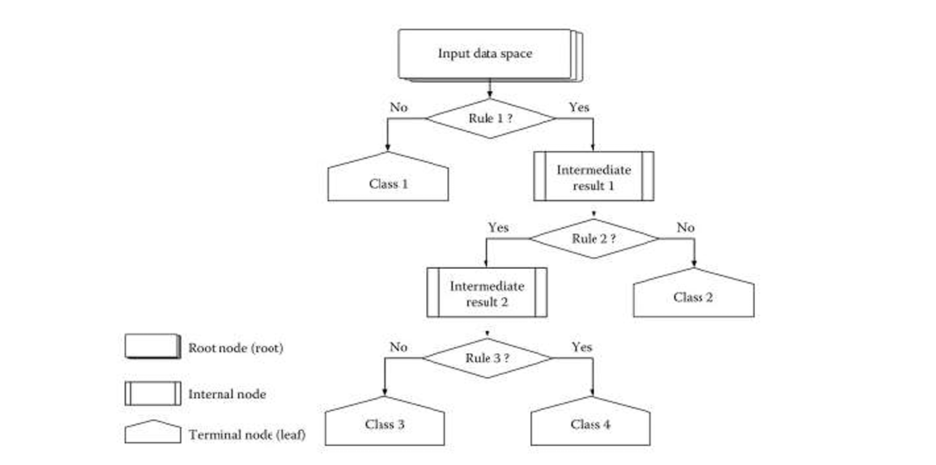

Slide 12
Random Forest Algorithm:
Random Forest Algorithm is a supervised learning algorithm used for both classification and regression. This algorithm works on 4 basic steps –
1. It chooses random data samples from dataset.
2. It constructs decision trees for every sample dataset chosen.
3. At this step every predicted result will be compiled and voted on.
4. At last most voted prediction will be selected and be presented as result of classification.
Naïve Bayes Algorithm:
Naive Bayes is an easy however amazingly powerful rule for prognosticative modeling. The independence assumption that allows decomposing joint likelihood into a product of marginal likelihoods is called as 'naive'. This simplified Bayesian classifier is called as naive Bayes. The Naive Bayes classifier assumes the presence of a particular feature in a class is unrelated to the presence of any other feature. It is very easy to build and useful for large datasets. Naive Bayes is a supervised learning model. Bayes theorem provides some way of calculative posterior chance P(b|a) from P(b), P(a) and P(a|b). Look at the equation below:
P(b v a)= P(a v b)P(b)/P(a)

Slide 13
P(b|a) is that the posterior chance of class (b,target) given predictor (a, attributes).
P(b) is the prior probability of class.
P(a|c)is that chance that is that the chance of predictor given class.
P(a) is the prior probability of predictor. In our system, Naïve Bayes decides which symptom is to put in classifier and which is not. 8.3 LOGISTIC REGRESSION Logistic regression could be a supervised learning classification algorithm accustomed to predict the chance of a target variable that is Disease.

Slide 14

LIST OF MODULES:
Pandas
NumPy
Tkinter

Slide 15
MODULES EXPLANATION:
Pandas:
It allows to you perform data manipulation and analysis in Python.
Pandas Python library offers data manipulation and data operations for numerical tables and time series.
Pandas provide an easy way to create, manipulate, and wrangle the data.
It is built on top of NumPy, means it needs NumPy to operate.
NumPy:
It consisting of multidimensional array objects and a collection of routines for processing those arrays.
Using NumPy, mathematical and logical operations on arrays can be performed.
NumPy is a Python package. It stands for 'Numerical Python’.

Slide 16
Tkinter: Python offers multiple options for developing GUI (Graphical User Interface). Out of all the GUI methods, Tkinter is the most commonly used method. It is a standard Python interface to the Tk GUI toolkit shipped with Python. Python Tkinter is the fastest and easiest way to create GUI applications. Creating a GUI using Tkinter is an easy task. To create a Tkinter Python app, you follow these basic steps: 1)Import the tkinter module: This is done just like importing any other module in Python. Note that in Python 2.x, the module is named ‘Tkinter’, while in Python 3.x, it is named ‘tkinter’. 2)Create the main window (container): The main window serves as the container for all the GUI elements you’ll add later. 3)Add widgets to the main window: You can add any number of widgets like buttons, labels, entry fields, etc., to the main window to design the interface as desired. 4)Apply event triggers to the widgets: You can attach event triggers to the widgets to define how they respond to user interactions.

Slide 17
UML DIAGRAMS:
Data-Flow Diagram:
In our healthcare diagnostic project, the Data Flow Diagram (DFD) serves as a crucial visual representation of how data moves within the system. This graphical tool illustrates various processes, data stores, data flows, and external entities, providing a high-level overview of the information flow. Processes within the DFD, such as data input, machine learning algorithms, and result presentation, are mapped to showcase their interactions and dependencies. Data stores, representing repositories for patient data and trained models, highlight where information is stored within the system. Data flows visually depict the movement of data between processes and data stores, illustrating the journey of input data as it undergoes processing, leading to the output of disease predictions. External entities, such as users or external systems, are integrated into the diagram to demonstrate how data is exchanged with the external environment. The DFD is instrumental in identifying potential bottlenecks, redundancies, and areas for optimization in the healthcare diagnostic framework, offering a comprehensive understanding of the data dynamics and ensuring the efficiency of data processing throughout the system.

Slide 18
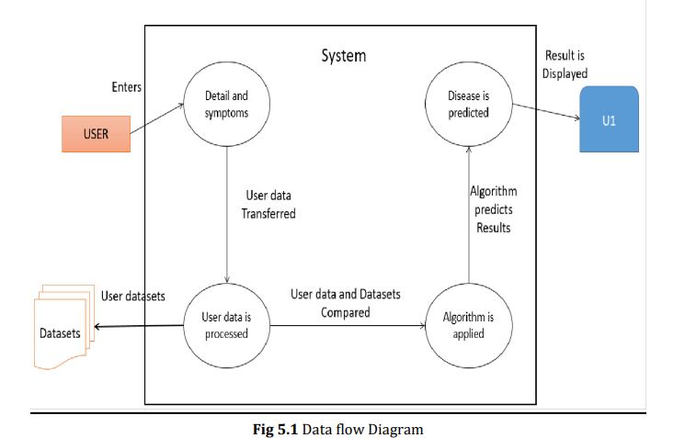

Slide 19
Entity-Relationship (ER) Diagram :
In our healthcare diagnostic project, the Entity-Relationship (ER) Diagram serves as a visual representation of the data model, illustrating the relationships between various entities within the system. Entities in the ER Diagram represent key components such as patients, medical records, and diagnostic results. Relationships between these entities, such as the association between patient data and diagnostic outcomes, are defined and visually depicted. Attributes of each entity, such as patient ID, symptoms, and disease predictions, are detailed within the ER Diagram, providing a comprehensive overview of the data structure. The ER Diagram aids in understanding the organization of data, ensuring clarity in the relationships between different components of the healthcare diagnostic framework. By utilizing the ER Diagram, our project aims to design a robust and well-structured data model that facilitates efficient data management, retrieval, and relationships essential for accurate disease predictions and comprehensive healthcare insights.

Slide 20
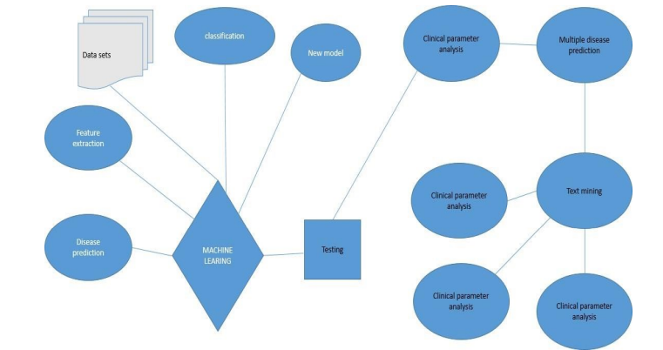

Slide 21
CODING:
from tkinter import *
import numpy as np
import pandas as pd
#symptoms
l1=['back_pain','constipation','abdominal_pain','diarrhoea','mild_fever','yellow_urine','yellowing_of_eyes','acute_liver_failure','fluid_overload','swelling_of_stomach','swelled_lymph_nodes','malaise','blurred_and_distorted_vision','phlegm','throat_irritation','redness_of_eyes','sinus_pressure','runny_nose','congestion','chest_pain','weakness_in_limbs','fast_heart_rate','pain_during_bowel_movements','pain_in_anal_region','bloody_stool','irritation_in_anus','neck_pain','dizziness','cramps','bruising','obesity','swollen_legs','swollen_blood_vessels','puffy_face_and_eyes','enlarged_thyroid','brittle_nails','swollen_extremeties','excessive_hunger','extra_marital_contacts','drying_and_tingling_lips','slurred_speech','knee_pain','hip_joint_pain','muscle_weakness','stiff_neck','swelling_joints','movement_stiffness','spinning_movements','loss_of_balance','unsteadiness','weakness_of_one_body_side','loss_of_smell','bladder_discomfort','foul_smell_ofurine','continuous_feel_of_urine','passage_of_gases','internal_itching','toxic_look_(typhos)','depression','irritability','muscle_pain','altered_sensorium','red_spots_over_body','belly_pain','abnormal_menstruation','dischromic_patches','watering_from_eyes','increased_appetite','polyuria','family_history','mucoid_sputum','rusty_sputum','lack_of_concentration','visual_disturbances','receiving_blood_transfusion','receiving_unsterile_injections','coma','stomach_bleeding','distention_of_abdomen','history_of_alcohol_consumption','fluid_overload','blood_in_sputum','prominent_veins_on_calf','palpitations','painful_walking','pus_filled_pimples','blackheads','scurring','skin_peeling','silver_like_dusting','small_dents_in_nails','inflammatory_nails','blister','red_sore_around_nose','yellow_crust_ooze’]

Slide 22
#Disease Names
disease=['Fungal infection','Allergy','GERD','Chronic cholestasis','Drug Reaction','Peptic ulcer diseae','AIDS','Diabetes','Gastroenteritis','Bronchial Asthma','Hypertension',' Migraine','Cervical spondylosis','Paralysis (brain hemorrhage)','Jaundice','Malaria','Chicken pox','Dengue','Typhoid','hepatitis A','Hepatitis B','Hepatitis C','Hepatitis D','Hepatitis E','Alcoholic hepatitis','Tuberculosis','Common Cold','Pneumonia','Dimorphichemmorhoids(piles)','Heartattack','Varicoseveins','Hypothyroidism','Hyperthyroidism','Hypoglycemia','Osteoarthristis','Arthritis','(vertigo) Paroymsal Positional Vertigo','Acne','Urinary tract infection','Psoriasis','Impetigo’]
l2=[]
for x in range(0,len(l1)):
l2.append(0)
# TESTING DATA df -------------------------------------------------------------------------------------
df=pd.read_csv("Training.csv")
df.replace({'prognosis':{'Fungal infection':0,'Allergy':1,'GERD':2,'Chronic cholestasis':3,'Drug Reaction':4,
'Peptic ulcer diseae':5,'AIDS':6,'Diabetes ':7,'Gastroenteritis':8,'Bronchial Asthma':9,'Hypertension ':10,
'Migraine':11,'Cervical spondylosis':12,'Paralysis (brain hemorrhage)':13,'Jaundice':14,'Malaria':15,'Chicken pox':16,'Dengue':17,'Typhoid':18,'hepatitis A':19,'Hepatitis B':20,'Hepatitis C':21,'Hepatitis D':22,'Hepatitis E':23,'Alcoholichepatitis’:24,'Tuberculosis’:25,'CommonCold’:26,'Pneumonia’:27,'Dimorphichemmorhoids
(piles)’:28,'Heart attack':29,'Varicoseveins':30,'Hypothyroidism':31,'Hyperthyroidism':32,'Hypoglycemia’:
33,'Osteoarthristis’:34,'Arthritis':35,'(vertigo) Paroymsal Positional Vertigo':36,'Acne':37,'Urinary tract infection':38,'Psoriasis':39,Impetigo':40}},inplace=True)

Slide 23
# print(df.head())
X= df[l1]
y = df[["prognosis"]]
np.ravel(y)
# print(y)
# TRAINING DATA tr --------------------------------------------------------------------------------
tr=pd.read_csv("Testing.csv")
tr.replace({'prognosis':{'Fungal infection':0,'Allergy':1,'GERD':2,'Chronic cholestasis':3,'Drug Reaction':4,'Pepticulcer diseae':5,'AIDS':6,'Diabetes ':7,'Gastroenteritis':8,'Bronchial Asthma':9,'Hypertension ':10,'Migraine':11,'Cervical spondylosis':12,'Paralysis (brain haemorrhage)':13,'Jaundice':14,'Malaria':15,'Chickenpox':16,'Dengue':17,'Typhoid’:
18,'hepatitis A':19,'Hepatitis B':20,'Hepatitis C':21,'Hepatitis D':22,'Hepatitis E':23,'Alcoholic hepatitis’:24,'Tuber
culosis’:25,'Common Cold':26,'Pneumonia':27,'Dimorphic hemmorhoids(piles)':28,'Heart attack’:29,'Varicose veins’:
30,'Hypothyroidism':31,'Hyperthyroidism':32,'Hypoglycemia':33,'Osteoarthristis':34,'Arthritis':35,'(vertigo) Paroymsal Positional Vertigo':36,'Acne':37,'Urinary tract infection':38,'Psoriasis':39,'Impetigo':40}},inplace=True)
X_test= tr[l1]
y_test = tr[["prognosis"]]
np.ravel(y_test)

Slide 24
# ------------------------------------------------------------------------------------------------------
def DecisionTree():
from sklearn import tree
clf3 = tree.DecisionTreeClassifier() # empty model of the decision tree
clf3 = clf3.fit(X,y)
# calculating accuracy-------------------------------------------------------------------
from sklearn.metrics import accuracy_score
y_pred=clf3.predict(X_test)
print(accuracy_score(y_test, y_pred))
print(accuracy_score(y_test, y_pred,normalize=False))
# -----------------------------------------------------
psymptoms = [Symptom1.get(),Symptom2.get(),Symptom3.get(),Symptom4.get(),Symptom5.get()]
for k in range(0,len(l1)):
# print (k,)
for z in psymptoms:
if(z==l1[k]):
l2[k]=1

Slide 25
inputtest = [l2]
predict = clf3.predict(inputtest)
predicted=predict[0]
h='no'
for a in range(0,len(disease)):
if(predicted == a):
h='yes'
break
if (h=='yes'):
t1.delete("1.0", END)
t1.insert(END, disease[a])
else:
t1.delete("1.0", END)
t1.insert(END, "Not Found")

Slide 26
def randomforest():
from sklearn.ensemble import RandomForestClassifier
clf4 = RandomForestClassifier()
clf4 = clf4.fit(X,np.ravel(y))
# calculating accuracy-------------------------------------------------------------------
from sklearn.metrics import accuracy_score
y_pred=clf4.predict(X_test)
print(accuracy_score(y_test, y_pred))
print(accuracy_score(y_test, y_pred,normalize=False))
# -----------------------------------------------------
psymptoms = [Symptom1.get(),Symptom2.get(),Symptom3.get(),Symptom4.get(),Symptom5.get()]
for k in range(0,len(l1)):
for z in psymptoms:
if(z==l1[k]):
l2[k]=1

Slide 27
inputtest = [l2]
predict = clf4.predict(inputtest)
predicted=predict[0]
h='no'
for a in range(0,len(disease)):
if(predicted == a):
h='yes'
break
if (h=='yes'):
t2.delete("1.0", END)
t2.insert(END, disease[a])
else:
t2.delete("1.0", END)
t2.insert(END, "Not Found")

Slide 28
def NaiveBayes():
from sklearn.naive_bayes import GaussianNB
gnb = GaussianNB()
gnb=gnb.fit(X,np.ravel(y))
# calculating accuracy-------------------------------------------------------------------
from sklearn.metrics import accuracy_score
y_pred=gnb.predict(X_test)
print(accuracy_score(y_test, y_pred))
print(accuracy_score(y_test, y_pred,normalize=False))
# -----------------------------------------------------
psymptoms = [Symptom1.get(),Symptom2.get(),Symptom3.get(),Symptom4.get(),Symptom5.get()]
for k in range(0,len(l1)):
for z in psymptoms:
if(z==l1[k]):
l2[k]=1

Slide 29
inputtest = [l2]
predict = gnb.predict(inputtest)
predicted=predict[0]
h='no'
for a in range(0,len(disease)):
if(predicted == a):
h='yes'
break
if (h=='yes'):
t3.delete("1.0", END)
t3.insert(END, disease[a])
else:
t3.delete("1.0", END)
t3.insert(END, "Not Found")
root = Tk()
root.configure(background='blue')

Slide 30
# entry variables
Symptom1 = StringVar()
Symptom1.set(None)
Symptom2 = StringVar()
Symptom2.set(None)
Symptom3 = StringVar()
Symptom3.set(None)
Symptom4 = StringVar()
Symptom4.set(None)
Symptom5 = StringVar()
Symptom5.set(None)
Name = StringVar()
# Heading
w2 = Label(root, justify=LEFT, text="DISEASE PREDICTION USING MACHINE LEARNING", fg="white", bg="blue")
w2.config(font=("Elephant", 30))
w2.grid(row=1, column=0, columnspan=2, padx=100)
w2.config(font=("Aharoni", 30))
w2.grid(row=2, column=0, columnspan=2, padx=100)

Slide 31
# labels
NameLb = Label(root, text="Name of the Patient", fg="yellow", bg="black")
NameLb.grid(row=6, column=0, pady=15, sticky=W)
S1Lb = Label(root, text="Symptom 1", fg="yellow", bg="black")
S1Lb.grid(row=7, column=0, pady=10, sticky=W)
S2Lb = Label(root, text="Symptom 2", fg="yellow", bg="black")
S2Lb.grid(row=8, column=0, pady=10, sticky=W)
S3Lb = Label(root, text="Symptom 3", fg="yellow", bg="black")
S3Lb.grid(row=9, column=0, pady=10, sticky=W)
S4Lb = Label(root, text="Symptom 4", fg="yellow", bg="black")
S4Lb.grid(row=10, column=0, pady=10, sticky=W)
S5Lb = Label(root, text="Symptom 5", fg="yellow", bg="black")
S5Lb.grid(row=11, column=0, pady=10, sticky=W)

Slide 32
lrLb = Label(root, text="DecisionTree", fg="white", bg="red")
lrLb.grid(row=15, column=0, pady=10,sticky=W)
destreeLb = Label(root, text="RandomForest", fg="white", bg="red")
destreeLb.grid(row=17, column=0, pady=10, sticky=W)
ranfLb = Label(root, text="NaiveBayes", fg="white", bg="red")
ranfLb.grid(row=19, column=0, pady=10, sticky=W)
# entries
OPTIONS = sorted(l1)
NameEn = Entry(root, textvariable=Name)
NameEn.grid(row=6, column=1)
S1En = OptionMenu(root, Symptom1,*OPTIONS)
S1En.grid(row=7, column=1)
S2En = OptionMenu(root, Symptom2,*OPTIONS)
S2En.grid(row=8, column=1)

Slide 33
S3En = OptionMenu(root, Symptom3,*OPTIONS)
S3En.grid(row=9, column=1)
S4En = OptionMenu(root, Symptom4,*OPTIONS)
S4En.grid(row=10, column=1)
S5En = OptionMenu(root, Symptom5,*OPTIONS)
S5En.grid(row=11, column=1)
dst = Button(root, text="DecisionTree", command=DecisionTree,bg="green",fg="yellow")
dst.grid(row=8, column=3,padx=10)
rnf = Button(root, text="Randomforest", command=randomforest,bg="green",fg="yellow")
rnf.grid(row=9, column=3,padx=10)
lr = Button(root, text="NaiveBayes", command=NaiveBayes,bg="green",fg="yellow")
lr.grid(row=10, column=3,padx=10)

Slide 34
#textfileds
t1 = Text(root, height=1, width=40,bg="orange",fg="black")
t1.grid(row=15, column=1, padx=10)
t2 = Text(root, height=1, width=40,bg="orange",fg="black")
t2.grid(row=17, column=1 , padx=10)
t3 = Text(root, height=1, width=40,bg="orange",fg="black")
t3.grid(row=19, column=1 , padx=10)
root.mainloop()

Slide 35
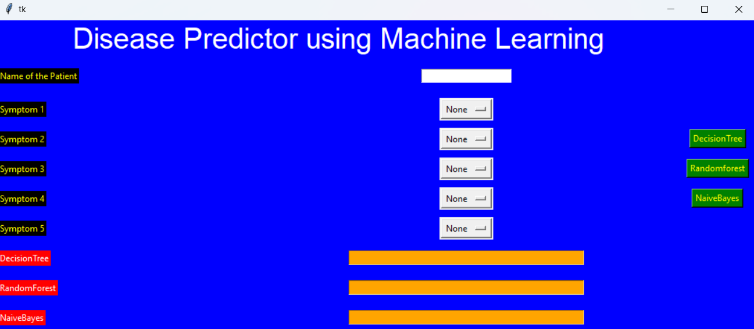
RESULT:

Slide 36
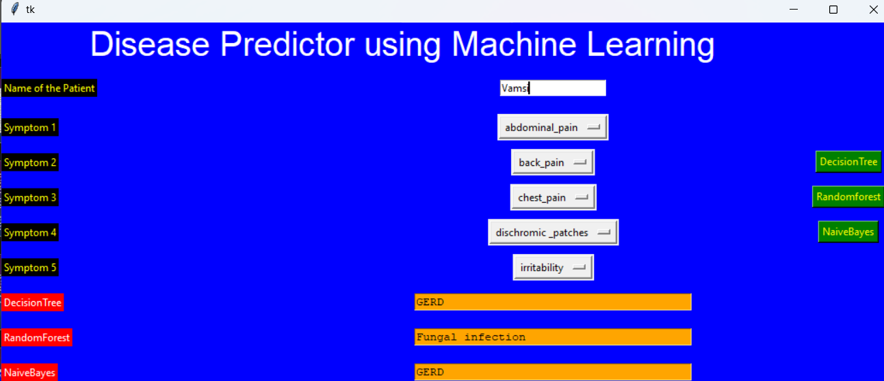

Slide 37
REFERENCES:
Sayantan Saha, Argha Roy Chowdhuri et,al “Web Based Disease Detection System”,IJERT, ISSN:22780181,Vol.2 Issue 4, April-2013
Shadab Adam et.al “Prediction system for Heart Disease using Naïve Bayes”, International Journal of advanced Computer and Mathematical Sciences, ISSN 2230- 9624, Vol 3,Issue 3,2012,pp 290- 294[Accepted- 12/06/2012].
Min Chen, Yixue Hao et.al “Disease Prediction by Machine Learning over big data from Healthcare Communities”, IEEE[Access 2017]
Mr Chintan Shah,Dr. Anjali Jivani, “Comparison Of Data Mining Classification Algorithms for Breast Cancer Prediction”, IEEE-31661
Palli Suryachandra, Prof.Venkata Subba Reddy,“Comparison of Machine Learning algorithms For Breast Cancer”, IEEE.
Andrew Alikberov, Stephan Broadly et.al “The Learning Machine”, Accessed on: March 26,2020. [Online]. Available: https://www.thelearningmachine.ai.

Slide 38
THANK YOU

